Slide 1


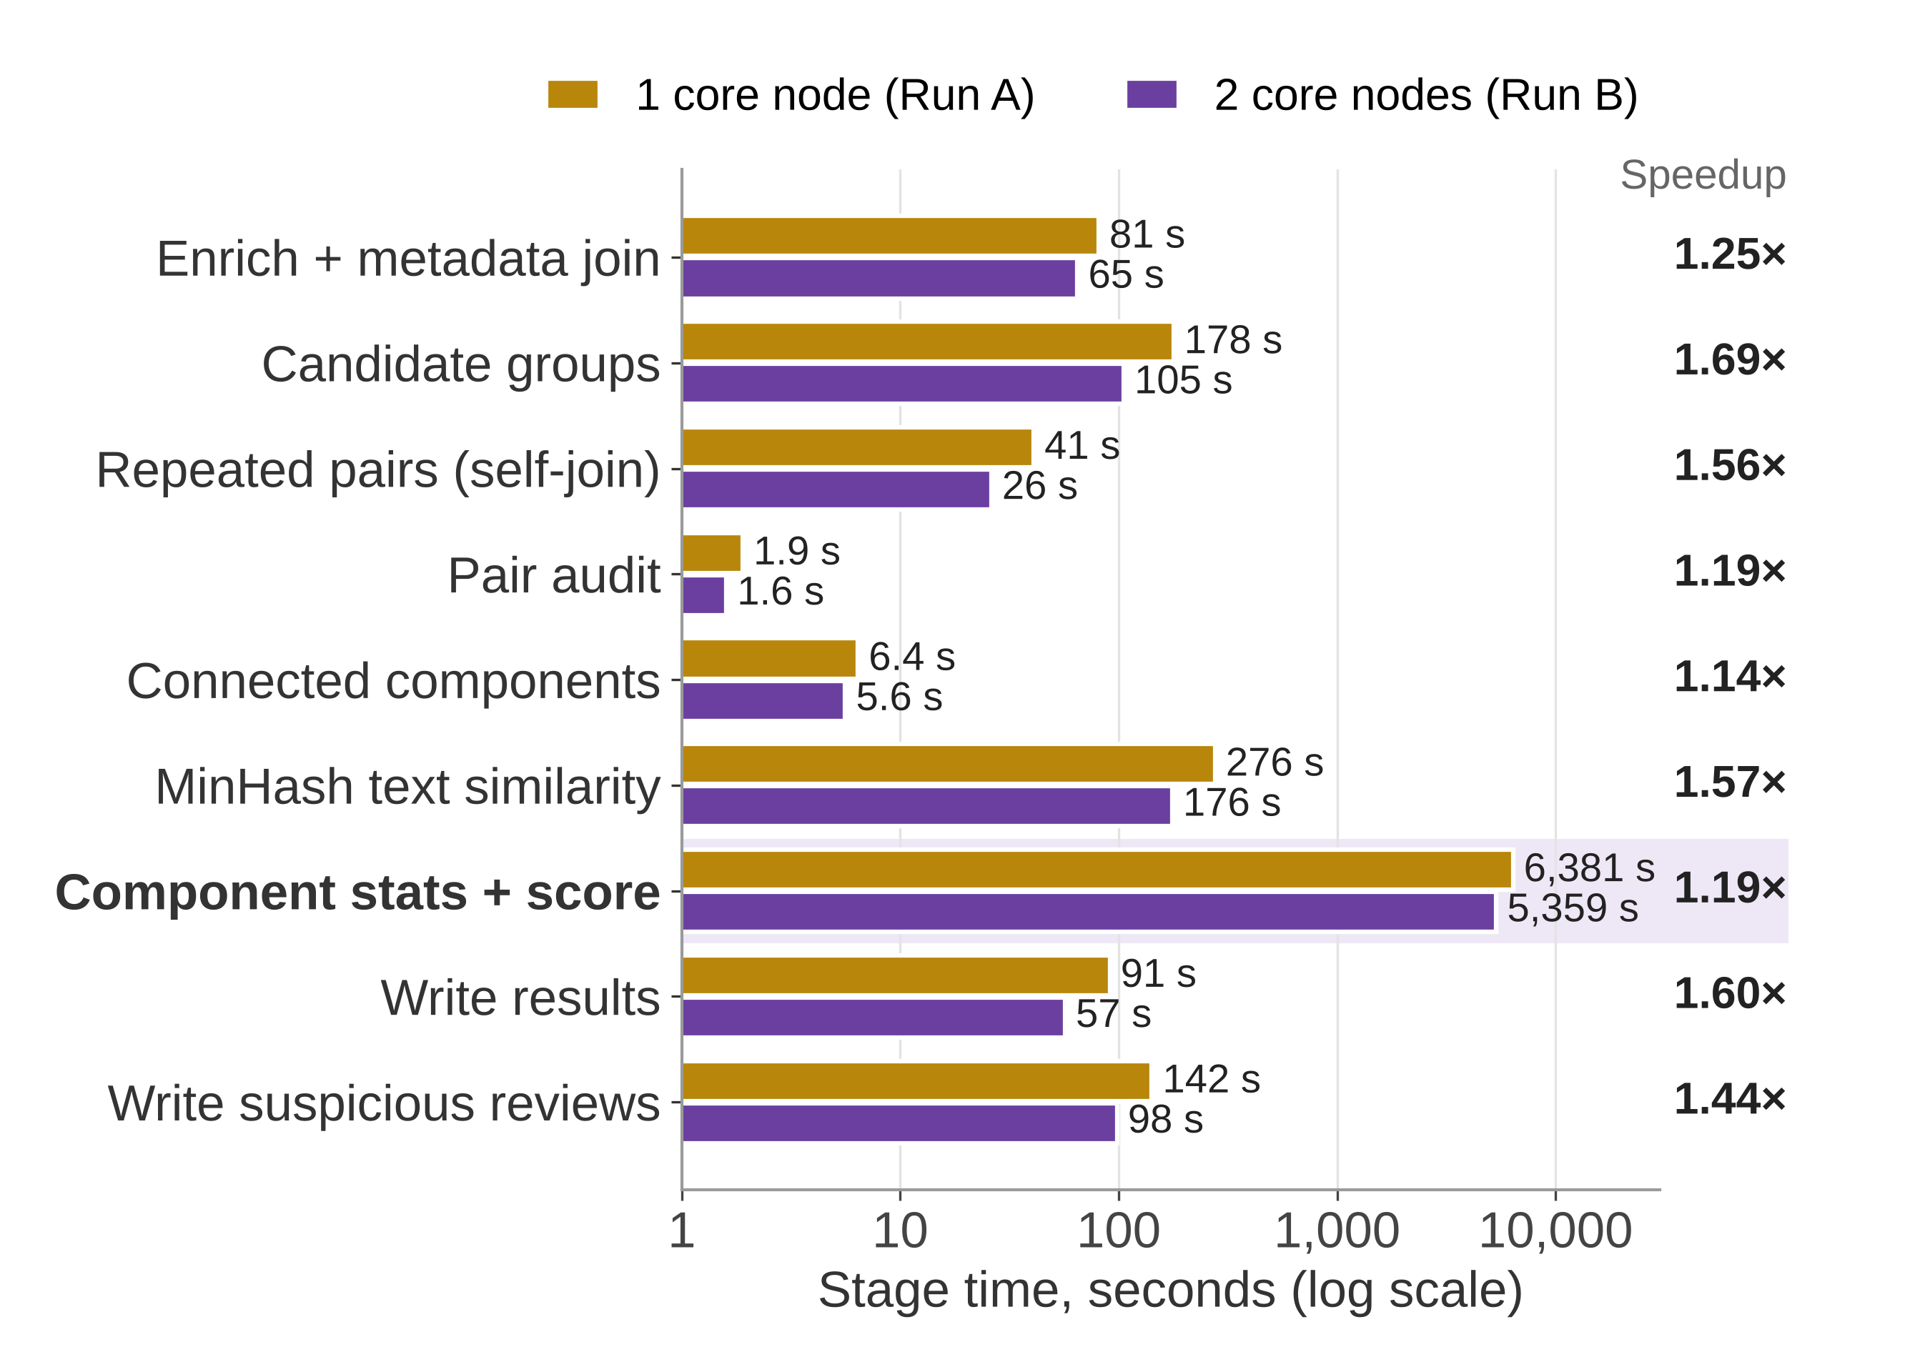
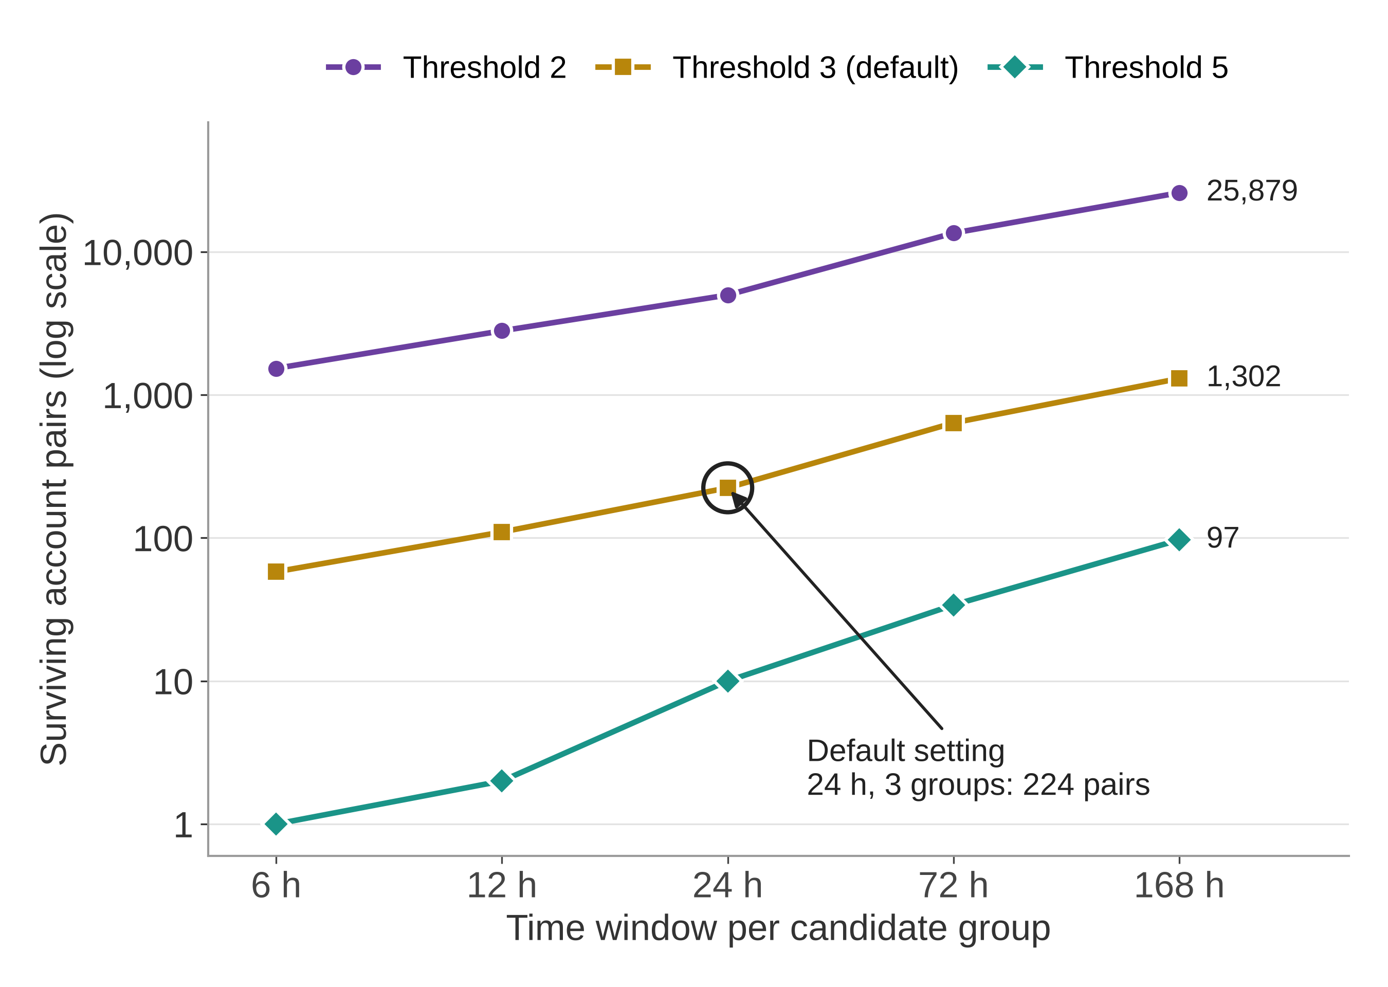
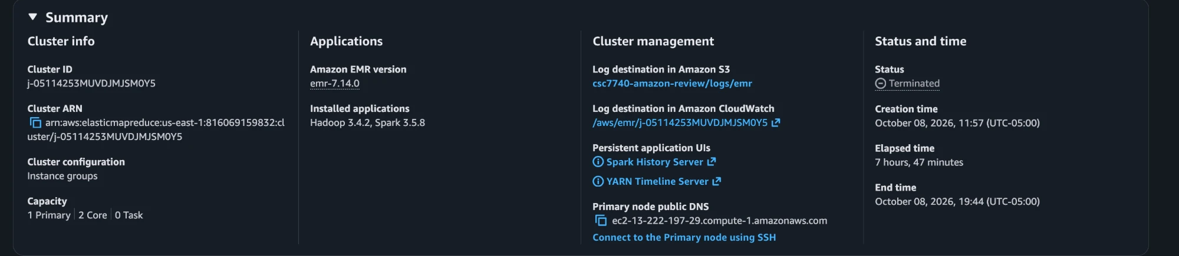
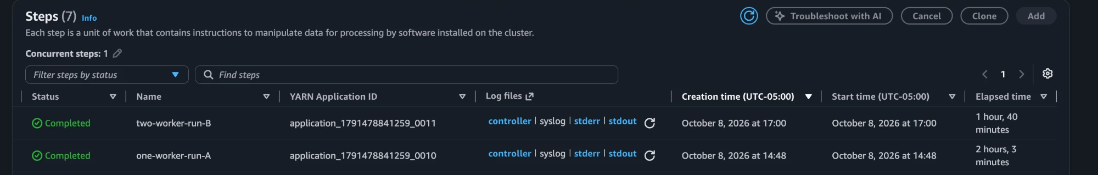
Identifying Coordinated Amazon Review Groups
with Distributed Text and Graph Analysis
Souhardya Saha Dip (ssahad1@lsu.edu) | Riyadil Zannat (rzanna2@lsu.edu) | Asif Faisal Chowdhury (achowd6@lsu.edu)
Louisiana State University, Baton Rouge, LA | CSC 7740 Big Data, Fall 2026
Prior CSC 4740 at LSU: none of the team members has taken CSC 4740.
Project Description
Big Data Frameworks
Datasets
Goal: find groups of Amazon accounts that review the same products inside the same short time windows again and again, across 24.4 million reviews.
Time buckets: reviews of one product in a fixed 24-hour bucket; buckets with more than 100 reviews are split into 6-hour buckets to reduce pair growth.
Co-review graph: two accounts are linked only if they share at least 3 distinct product-time groups. Same-base ID pairs (X and X_1) are filtered as suspected artifacts.
Candidate groups: GraphFrames connected components of this graph, ranked by a 7-signal score: size, density, repetition, MinHash text similarity, time concentration, deviation from catalog rating, and rating agreement.
Use: a ranked review queue for human moderators. A flagged group is a candidate, not a fraud label.
Apache Spark 3.5, PySpark DataFrame API + Spark SQL: explicit schemas, distributed metadata join, time bucketing, and the self-join that builds account pairs (400 shuffle partitions on EMR).
Spark MLlib MinHashLSH: word-token sets, HashingTF (2^18 features), 5 hash tables, seed 42; cross-account matches within components, with a 0.70 similarity cutoff and 30+ characters.
GraphFrames 0.8.4: connectedComponents(algorithm="graphx") with a checkpoint directory, plus a DataFrame label-propagation fallback (USE_GRAPHFRAMES=0).
Apache Parquet + Amazon S3: ranked groups and review evidence; optional enriched Parquet by category/year was disabled in both EMR benchmarks.
AWS EMR on EC2: YARN cluster, client mode, 4 GB driver; the same code runs locally and on EMR through environment variables.
Amazon Reviews'23 (McAuley Lab, UC San Diego): https://amazon-reviews-2023.github.io/
Reviews: mcauleylab.ucsd.edu/public_datasets/data/amazon_2023/raw/review_categories/
Metadata: mcauleylab.ucsd.edu/public_datasets/data/amazon_2023/raw/meta_categories/
Format: gzip JSON Lines, one file per category, joined on parent_asin. 4.76 GB compressed, 17.14 GB raw.
Category | Reviews | Products | Raw
Arts, Crafts & Sewing | 8,966,758 | 801,446 | 6.12 GB
Baby Products | 6,028,884 | 217,724 | 3.64 GB
CDs & Vinyl | 4,827,273 | 701,959 | 4.24 GB
Video Games | 4,624,615 | 137,269 | 3.12 GB
Total (1996-2023) | 24,447,530 | 1,858,398 | 17.14 GB
1. Read JSONL
explicit schemas, S3
2. Join metadata
parent_asin, rating dev.
3. Product-time groups
24 h, 6 h if >100
4. Account pairs
self-join per group
8. Write Parquet
ranked groups + evidence
7. Score + rank
7 signals + MinHash
6. Components
GraphFrames
5. Edges
3+ groups, audit IDs
Raw sizes include reviews + metadata; GB = 10^9 bytes.
Development Details
Main Results & Screenshots
Conclusion & Future Work
Computing environments
24.4M
reviews ingested
20.6M
product-time groups
1,051
pairs in 3+ groups
1,038
edges after audit
1,294
accounts in graph
443
candidate groups
What we learned
API choice is a performance choice: moving from row-based Python code to DataFrames turned a job that could not finish into one that does.
Profile before explaining: the stats + score timer dominates runtime; isolate deferred work before claiming a specific root cause.
One default can break a cluster: local filesystem defaults and incomplete HDFS paths caused failures during cluster setup.
Report your thresholds: the same data gives answers that differ by orders of magnitude.
Limitations
No ground truth: shared households, product launches or Vine can also cause co-reviews, so flagged groups need human review.
Components are transitive: one bridge can join groups. Fixed buckets can separate reviews minutes apart.
Score weights are hand chosen, not probabilities. Rating/time signals use members’ full input histories.
Future work
1. Persist reused joins; measure runtime over repeated trials.
2. Use Parquet input to improve scan parallelism.
3. Test stable review IDs and deterministic text results across cluster sizes.
4. Validate weights with independent labels and realistic mixed-product tests.
5. Extend category coverage and evaluate a streaming mode.
Setting | Configuration
Local baseline | Linux workstation, PySpark 3.5, local[4], 8 GB driver
Cloud cluster | AWS EMR 7.14.0: Hadoop 3.4.2, Spark 3.5.8, JDK 17, YARN
Nodes | 1 primary + 1 core (Run A) or 2 core (Run B), all m5.xlarge (4 vCPU, 16 GB)
Storage | Amazon S3 for input, code, logs and Parquet results
Cost | $6.11 total AWS cost (Cost Explorer); 7.78 h cluster lifetime
These aggregate graph counts match in both EMR logs; text matches and some rankings differ.
A. Scale-out on EMR, full corpus
B. Threshold and window sensitivity (Video Games)
Scale-out: one to two workers reduced runtime from 7,368.6 s to 6,030.4 s (1.22×; 18.2% less time), one trial each. The stats + score timer accounts for 86.6% of Run A and includes deferred Spark work. Repeated joins and gzip scans are suspected bottlenecks.
Sensitivity: at 24 h, raising the threshold from 2 to 3 removes 95.5% of pairs (4,989 to 224). At threshold 3, widening 24 h to 168 h gives 5.8× more pairs and a 328-account component; the cause needs investigation.
Groups: 367 of 443 components are two-account pairs, 76 have 3+ accounts, 4 have 10+. Text matches: 34 pairs in 6 components (Run A) vs. 32 in 5 (Run B).
EMR console: capacity 1 primary + 2 core after the resize; both full-corpus steps Completed (Run A 2 h 3 min, Run B 1 h 40 min).
Technical challenges and fixes
Out of memory: the first version turned every review into a Python object and ran out of heap at 24.4M rows. Rewriting it with DataFrame expressions fixed this (Video Games: 1,003 s to 617 s).
Schema inference failed: metadata keys differ only by letter case. We use explicit schemas for the 8 review and 4 metadata fields we need.
ID artifacts: same-base IDs co-reviewed up to 464 groups. The rule flags 28 pairs and removes 13 same-base pairs; shared identity is not confirmed.
Cluster failures: local filesystem settings and host-less HDFS paths caused EMR failures. Local defaults are now isolated and cluster paths fully qualified.
Slow graph step: default GraphFrames launched hundreds of stages on a small graph; algorithm="graphx" fixed it.
Selected candidate groups (Run A)
Validation: 6 synthetic patterns
Rank | Accts | Edges | Reviews | Mean shared | Text pairs | Score
1 | 2 | 1 | 64 | 11.0 | 1 | 0.649
2 | 2 | 1 | 19 | 5.0 | 14 | 0.645
7 | 3 | 3 | 37 | 9.3 | 0 | 0.554
19* | 223 | 331 | 33,694 | 4.1 | 3 | 0.504
Synthetic pattern | Account recall
R1-R3: 3, 5, 10 accounts | 100%
R4: only 2 products | 0% (by design)
R5: spread past 24 h | 0% (by design)
R6: partial, 8 accounts | 7/8 (87.5%)
24.4M reviews to 443 ranked candidate groups
1.22× measured speedup with two EMR workers.
Candidate groups require human review.
*Largest: density 0.013; may contain bridging accounts. Reviews cover members’ full input histories.
Video Games test, synthetic product IDs. Tests rule recovery, not fraud accuracy or real-account contamination.
Notes:
Sources: AmazonReviewCoordinationDF.py (load_enriched, add_group_key, repeated_pairs, pair_audit, component_stats, text_similarity, main); analysis/injection.py; analysis/sensitivity.py; report/final_report.pdf sections 2.3 and 4.3; report/evidence/runA-one-worker and runB-two-workers stdout/controller logs. Dataset: https://amazon-reviews-2023.github.io/ . Benchmark counts and runtimes are directly supported by saved logs. Stage timers include deferred Spark work and do not isolate operator costs. Both controlled EMR runs set WRITE_ENRICHED=0. Corpus byte sizes, AWS cost, sensitivity results, component-size distribution and aggregate text-pair totals are reported in the supplied report; full data, Parquet results, billing export and experiment CSVs are absent from this checkout. The planted-product construction tests rule recovery on isolated synthetic products, not contamination under shared real products. Numeric-suffix removal is a heuristic, not confirmed identity resolution. MinHash variation has been observed; its cause is not established by these materials. No full-corpus rerun was performed for this poster review.

